Slide 1
Welcome
Planning and Managing a Successful Project
Notes:
Welcome have the room stand up and
sit down if:
new to racing
worked on a car but never attended a race
Participated in a race
Participated in two races
Three races
Four
Five
Six
Who is left ask when their addiction started

Slide 2
Project Mission and Vision
  What is the purpose of the project deliverables/benefits of the effort
    Focus on the project (What, Why, How)
    Imagine what would be written in a news story about your effort at the project’s SUCCESSFUL CONCLUSION
Notes:
Focus beyond the just the car
Take time to explore each critical area
Avoid the purpose of the organization and just look at your current project

Slide 3
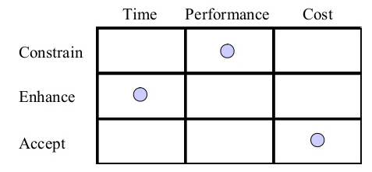
Project Objective Balancing
PERFORMANCE
?
?
TIME
COST
CUSTOMERS EXPECTATIONS

Slide 4
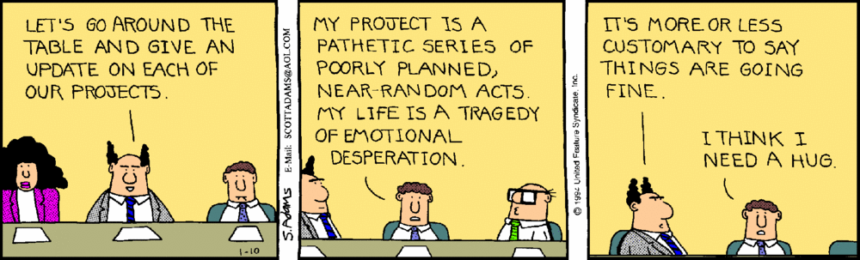
Reality Check

Slide 5
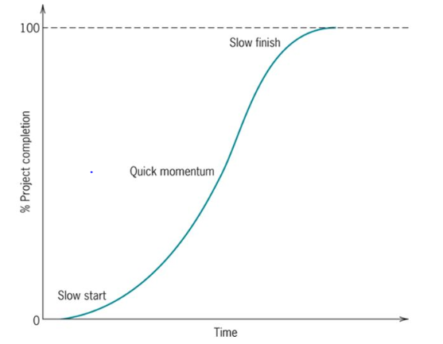
Living the project life
Meredith & Mantel (2009) Project Management, a Managerial Approach
Notes:
Things start off slow, but build quickly
The end is always an after thought for many, but plan for after the event to ensure loose ends are completed and documentation is made for the future

Slide 6
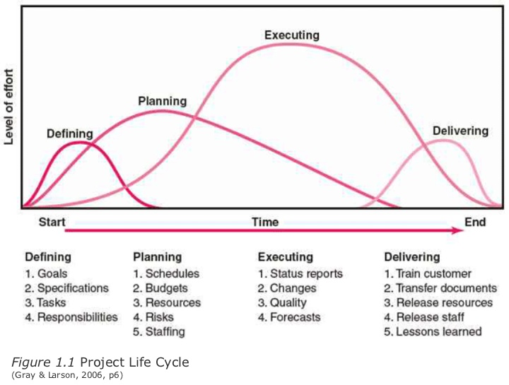
Living the project life
Notes:
Leadership must never stop planning the project.
Nothing ever goes perfectly according to plan developed at the start
Don’t over plan, you have to give time for your efforts to produce
Assess risk and know where you have weaknesses, review those areas more frequently

Slide 7
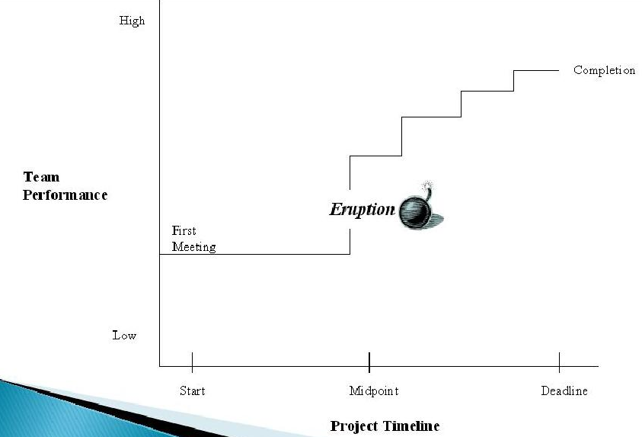
Living the project life
Punctuated Equilibrium
Pearson Education, Inc. Publishing as Prentice Hall (2013)
Notes:
There comes this O’CRAP moment about half way through where you realize how little time you have
Tomorrow’s session on scheduling will talk about how to help avoid that from happening

Slide 8
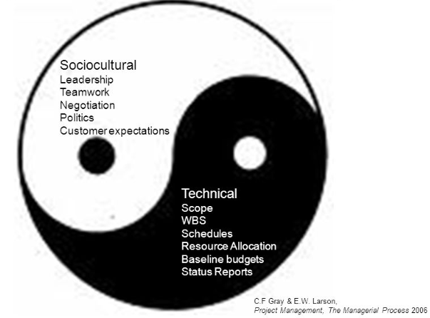
People, people, people
YES, you must address the elephant in the room, PEOPLE on you team
  Attitudes
  Experience
  Demands
  Assumptions
  Whims
Notes:
You must learn as leaders to properly blend the technical with the social
This at times requires the team to celebrate success
And times to realize and acknowledge failure
Remember conflict is part of the process and managed well will drive higher performance
RESPECT is key

Slide 9
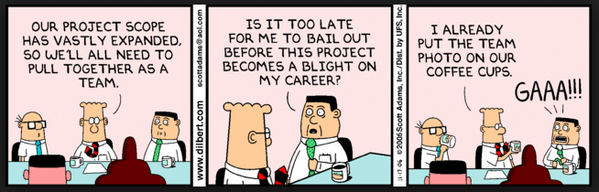
Functional Operations
Identify the core operations required to achieve the goals
  Membership Management (recruitment/retention of skilled members)
  Administrate services
  Fundraising and marketing
  Design, construction, and testing
  Event logistics
Notes:
Think big picture as you consider what areas need to be covered
Identify natural areas of study on your campus that can fill those needs
Every team will organize differently based on what skill sets are available to them
No matter what there are these five primary core areas that must be included

Slide 10
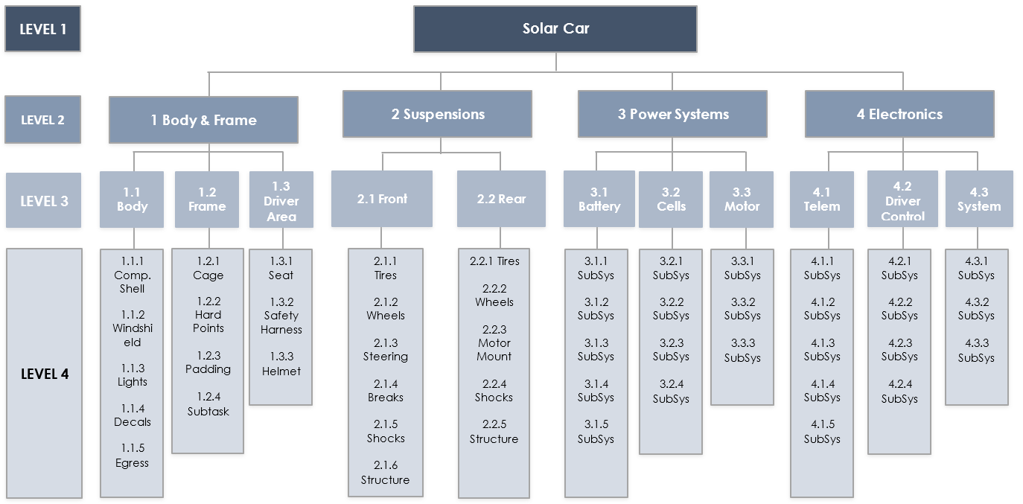
Work Breakdown
Notes:
WBS are the framework from which all of your technical planning will be generated
Do a good job here and much of the other aspects will fall into place
Suggest using a systems approach vs a task approach when addressing your vehicle
This approach can also be used to outline your other areas as well
Most like to see this in a graphical format
But an excel outline will fit better when adding details to the overall list
Software like MS Project can help guide you in this exercise
BUT
Don’t let the complexity of software think that it is a solution to planning, it is a tool and can be overkill and rob you of effort if you let it

Slide 11
Design, reporting, building
Design Reviews and Processes
  Acknowledge the learning exercise & expertise is required for success
Process to “sign-off” by experienced professionals
Objective goals NOT subjective feelings
Engineering NOT hunches
Manufacturing capabilities NOT hopes and dreams
Notes:
Over the years I have heard the statement by good engineers
Trust me this has to work
Without any time spent on doing the engineering/assessment
That is fine if you are just hanging a picture
BUT in this case you are going to put a friend in this vehicle and ask them to trust their life to your work on open highways
Not a time to just guess
DO THE ENGINEERING

Slide 12
Design, reporting, building
Limit number of design groups to limit system integration points between groups
Ensure each group has seniors/juniors who have completed key course of study required for the systems being designed
Include experienced faculty/staff/experts for each system design group
Ensure good communication, designs are an iterative process
Include freshman and sophomores on each design group to ensure future design team leadership

Slide 13
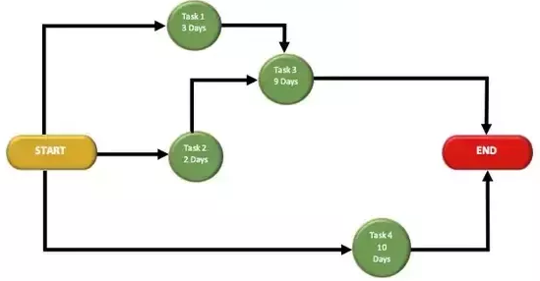
Manufacturing Flow & PERT charts
Understanding Limitations
Human skill availability
Physical space availability
Equipment accessibility
Purchasing regulations and limitations (bids, contracts, etc.)
Incomplete designs or delayed design reviews
Impact of downtime waiting on others, the social/TEAM impact
Notes:
Understand what you really have to work with
To often I have heard of designs that are very cool but the ability to build is just not there
Take time once you start building to make sure all know where the critical paths are in your schedule
Arrange extra time with commitments form members to complete those items on those paths
Be careful not to rob other areas where they are short resources and become critical

Slide 14
Time & Budgets
Saturday session on Scheduling and Budgets
Calendar days vs working days
School schedule and holidays (real & artificial)
Lead times on materials and processes
Communicate downstream needs to maintain current schedule
Remember to spend money you must raise money first
Fundraising takes time too
Notes:
Arrange in slack times
Be prepared to ask for commitments from key team members to work during non school periods
Be aware of the natural flow of education with tests, projects, end of terms, and long weekends
Have a back up plan if cash becomes short
Monitor cash flow and variances from your budget to avoid coming up short
Plan to have left over money in your account, but shhhh don’t tell everyone that never stop fundraising

Slide 15
TESTING
TEST – TEST – TEST!
Testing should start in your design phase measuring against stated objective design goals
Continuously evaluate all aspects of the project, not just a car
Plan time for adjustments to ensure performance
Model your car’s final performance
Can you predict actual performance with your models?

Slide 16
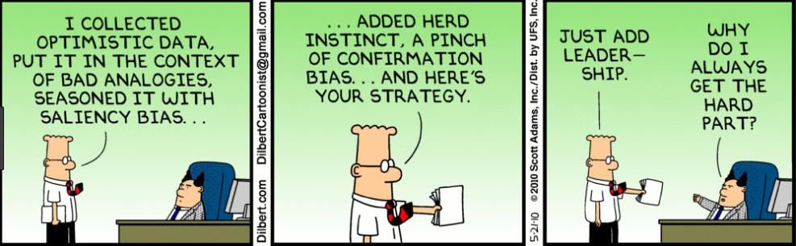
Final Thoughts
What is it you are doing?
What are you willing to give to succeed?
Can it be accomplished without a dedicated TEAM?
Notes:
You are designing a one of a kind vehicle
Your prototype is your final product
It is a reflection of you and every member of your team
It is real not imaginary
It must be able to safely transport a real person on US highways
It will also carry your reputation
Leave nothing on the table, give it your all
I have never met a member of a team that regretted participating in an event
I have met plenty who have regretted not devoting more time to achieve what is truly possible
The social engagements you miss, the extra vacation time at home you sacrifice, the summer job you give up, will all have been worth the sacrifice of you honestly give it your all as a team
This is a once in a lifetime experience that you will never get a chance to repeat, all the other things you sacrifice will be available to you for a lifetime
You will succeed as a team or fail as a team
Remember that not all team members are able to equally contribute, appreciate what each person brings to the project
Conflict is a natural part of working as a team
Avoid it becoming personal
Keep it focused on the objectives set in your project plan A Safe and Reliable Solar Car

Slide 17


