Slide 1
Welcome
Scheduling & Budget
Deep Dive
Notes:
Welcome have the room stand up and
sit down if:
new to racing
worked on a car but never attended a race
Participated in a race
Participated in two races
Three races
Four
Five
Six
Who is left ask when their addiction started

Slide 2
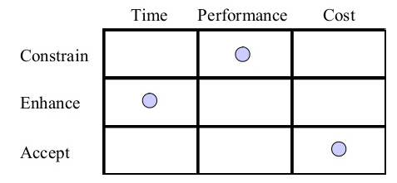
Project Objective Balancing
PERFORMANCE
?
?
TIME
COST
CUSTOMERS EXPECTATIONS

Slide 3
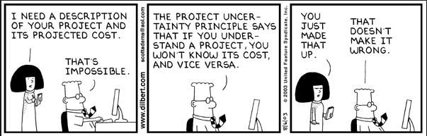
Living the project life
Notes:
Leadership must never stop planning the project.
Nothing ever goes perfectly according to plan developed at the start
Don’t over plan, you have to give time for your efforts to produce
Assess risk and know where you have weaknesses, review those areas more frequently

Slide 4
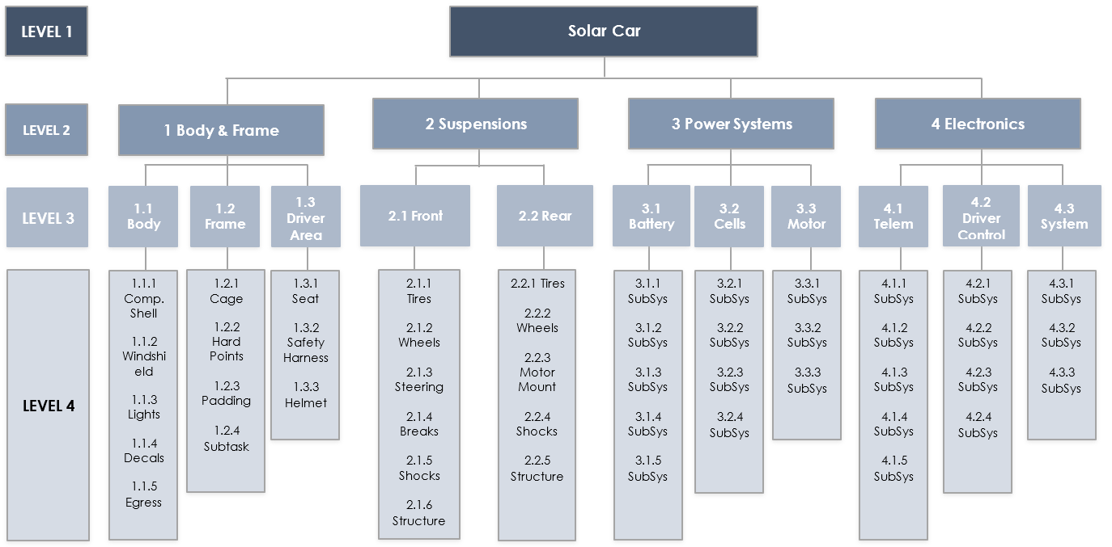
Work Breakdown
Notes:
This is the framework we will use to guide our budget efforts
We will be budgeting time and resources (cost)

Slide 5
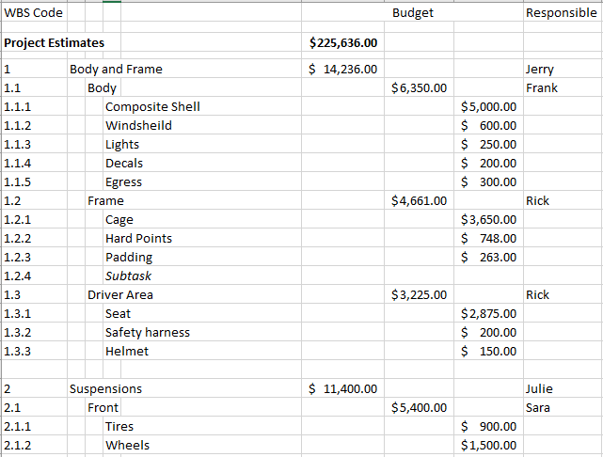
WBS to Budget
Notes:
This was done in Excel quickly, there are software pacakges out there that can support this as well.

Slide 6
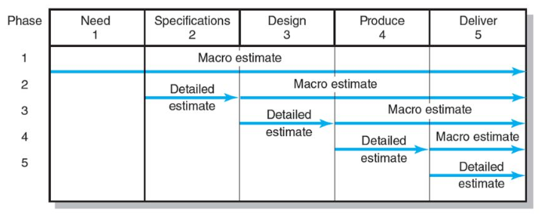
Estimation Approach
Notes:
For many of you, the estimations needed to detail a budget for $$$ is impossible as you do not yet know the design (materials and such) and methods needed to build
You can, once a route is out, work the details on that item
You can do a reasonable job with fundraising and marketing from knowing your budget
This is an iterative process that will take a few rounds to bring the big picture together

Slide 7
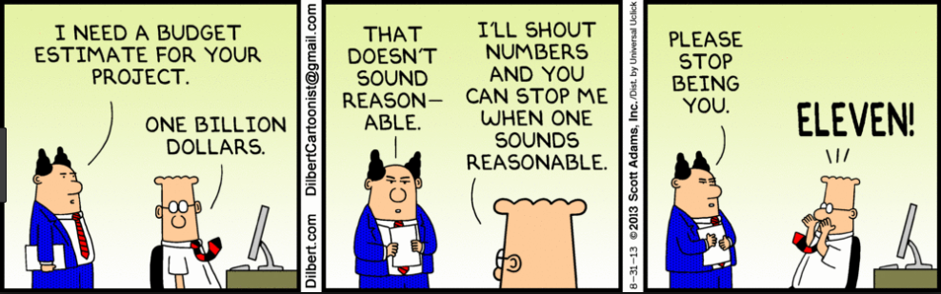
Project Mission and Vision
Notes:
Focus beyond the just the car
Take time to explore each critical area
Avoid the purpose of the organization and just look at your current project

Slide 8
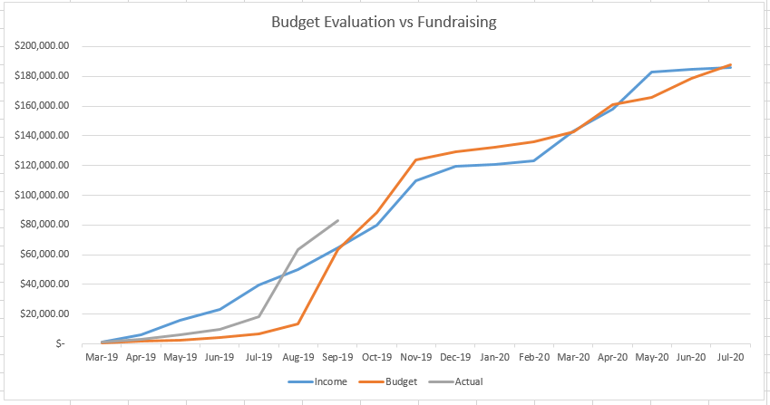
How to plan cash flow
Notes:
Switch to the spreadsheet to do some what ifs

Slide 9
So what about Income
Income source can include grants, donations, University funding, endowments, and more
University funding and endowment revenue are often know values, the rest must be discovered
Grants often have lead times that have to be considered and are sort of like applying for scholarships
Donors must know who you are to want to invest
Donor management is in itself a major project just like building the car

Slide 10
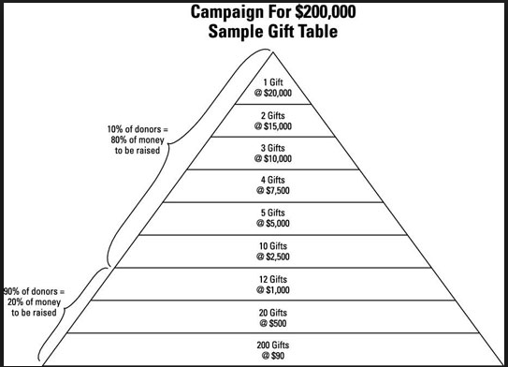
Notes:
You need a minimum of 4 to 8 prospects for every budgeted gift

Slide 11
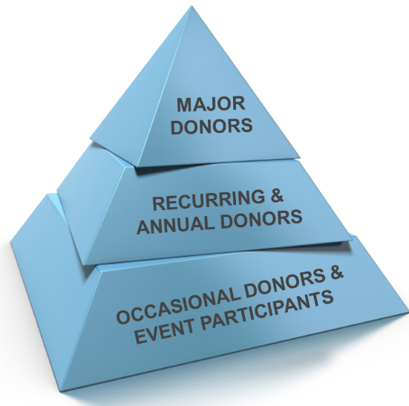
Donor Profile
Notes:
Who are your donors

Slide 12
Donor Management
Keep donors informed, help them feel the excitement
Don’t under ask, know your donor’s ability to give, do some research, know what they care about and make a connection
Believe in your ability, have confidence in what you are doing by take care to do it right
Communicate when funding is needed and why
Ask for support annually for recurring donors, make your request in advance of their normal gift giving period
Have programs that allow members to easily ask acquaintances to bring them into the donor pool, set a goal for each member

Slide 13
How to know When you need $$$$$
Notes:
Switch to the spreadsheet to do some what ifs

Slide 14
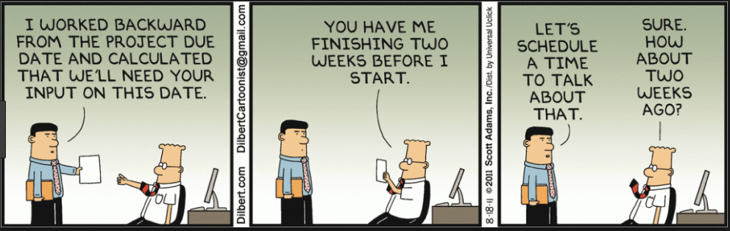
Scheduling

Slide 15
Time
Calendar days vs working days
School schedule and holidays (real & artificial)
Lead times on materials and processes
Communicate downstream needs to maintain current schedule
Notes:
Arrange in slack times
Be prepared to ask for commitments from key team members to work during non school periods
Be aware of the natural flow of education with tests, projects, end of terms, and long weekends
Have a back up plan if cash becomes short
Monitor cash flow and variances from your budget to avoid coming up short
Plan to have left over money in your account, but shhhh don’t tell everyone that never stop fundraising

Slide 16
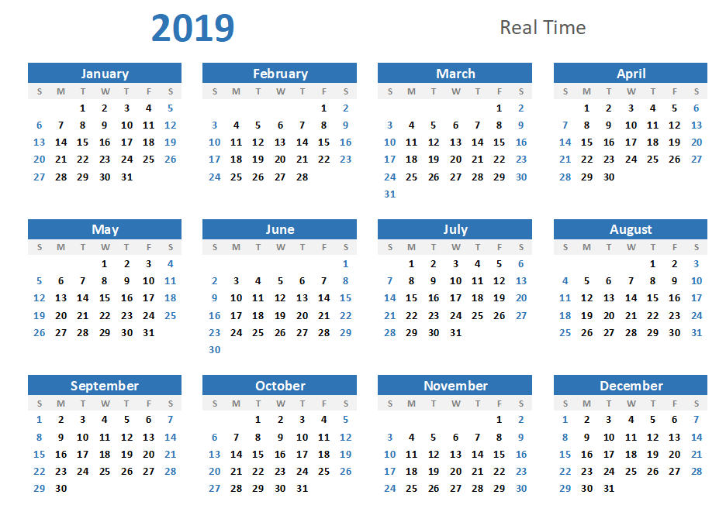

Slide 17
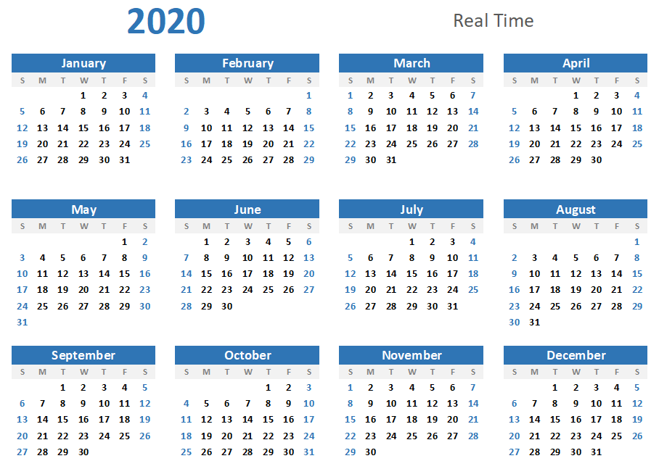

Slide 18
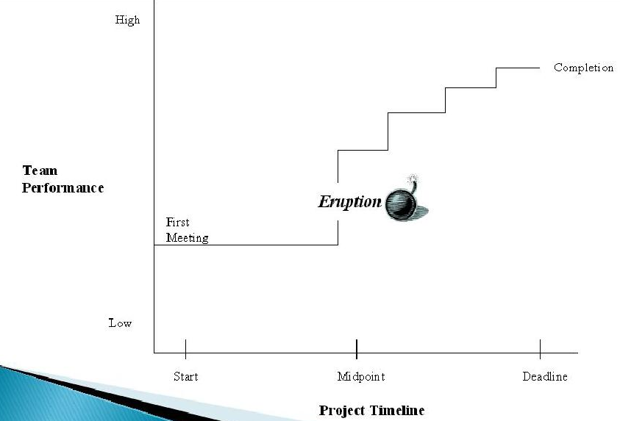
Living the project life
Punctuated Equilibrium
Pearson Education, Inc. Publishing as Prentice Hall (2013)
Notes:
There comes this O’CRAP moment about half way through where you realize how little time you have
Tomorrow’s session on scheduling will talk about how to help avoid that from happening

Slide 19
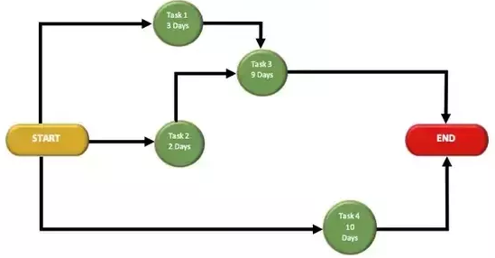
Manufacturing Flow & PERT charts
Notes:
Understand what you really have to work with
To often I have heard of designs that are very cool but the ability to build is just not there
Take time once you start building to make sure all know where the critical paths are in your schedule
Arrange extra time with commitments form members to complete those items on those paths
Be careful not to rob other areas where they are short resources and become critical

Slide 20
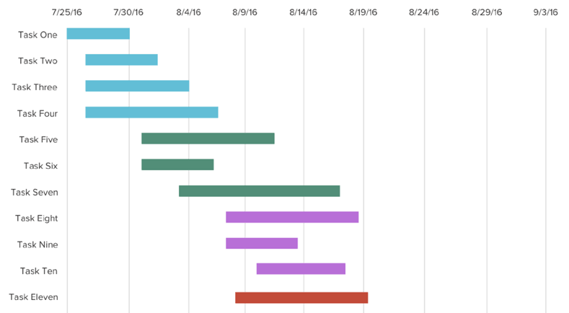
Gantt charts
Notes:
Easy to create in excel
MS Project even better

Slide 21
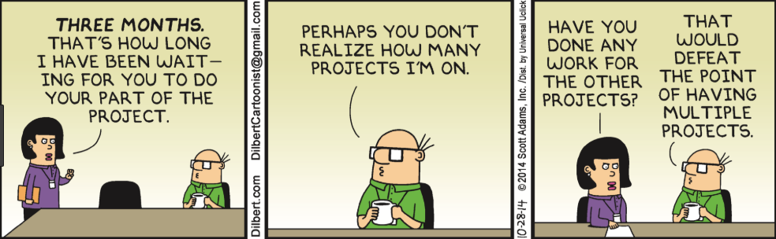
Who is doing what

Slide 22
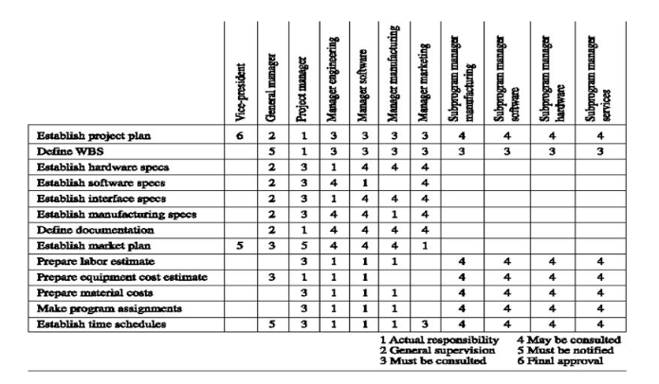
Organization Breakdown
System/Task Breakdown
Notes:
This can be created for resources like space and or equipment
Compare this to your schedule with start and end dates to see if you have overloaded a person or resource
Software packages can assist with this like MS Project

Slide 23
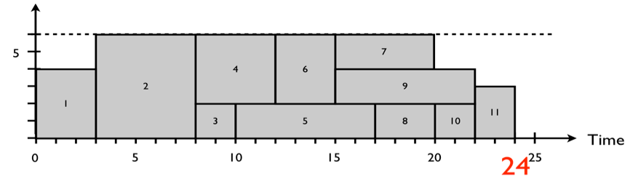
Resource Leveling

Slide 24
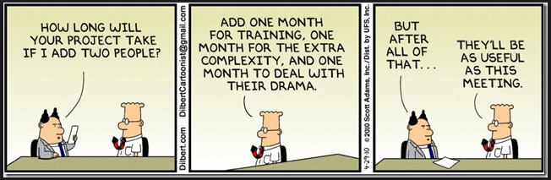
Adding People???
Notes:
Things start off slow, but build quickly
The end is always an after thought for many, but plan for after the event to ensure loose ends are completed and documentation is made for the future

Slide 25
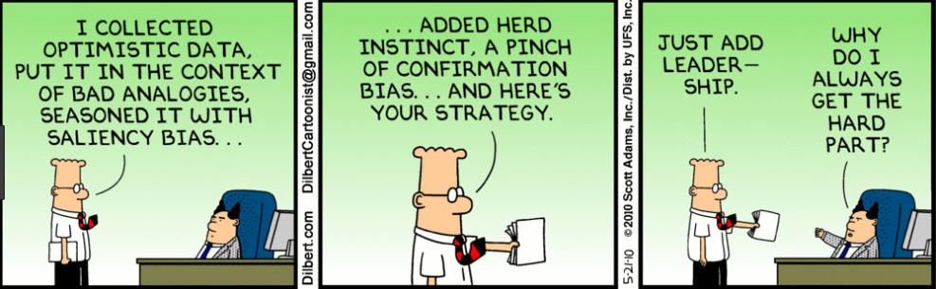
Final Thoughts
Notes:
You are designing a one of a kind vehicle
Your prototype is your final product
It is a reflection of you and every member of your team
It is real not imaginary
It must be able to safely transport a real person on US highways
It will also carry your reputation
Leave nothing on the table, give it your all
I have never met a member of a team that regretted participating in an event
I have met plenty who have regretted not devoting more time to achieve what is truly possible
The social engagements you miss, the extra vacation time at home you sacrifice, the summer job you give up, will all have been worth the sacrifice of you honestly give it your all as a team
This is a once in a lifetime experience that you will never get a chance to repeat, all the other things you sacrifice will be available to you for a lifetime
You will succeed as a team or fail as a team
Remember that not all team members are able to equally contribute, appreciate what each person brings to the project
Conflict is a natural part of working as a team
Avoid it becoming personal
Keep it focused on the objectives set in your project plan A Safe and Reliable Solar Car

Slide 26


